Slide 1
Implementation and application of Ternary Search Tree

Slide 2
Introduction
In this project we are implementing ternary search tree and autocompletion using ternary search tree. We are doing analyses and comparison of ternary search tree with other prefix trees.
Ternary search tree is a type of trie also called as prefix tree in which nodes are arranged in a manner similar to a binary search tree, but with up to three children rather than the binary tree’s limit of two.

Slide 3
Like other prefix trees, a ternary search tree can be used as an associative map structure with the ability for incremental string search. However, ternary search trees are more space efficient compared to standard prefix trees, at the cost of speed.
By using ternary search tree we can insert , delete or search a element in O(log n) in average case. where n is number of nodes.

Slide 4
Properties
Every node in a ternary search tree contains only 3 pointers.
The left pointer points to the node whose value is less than the value in the current node.
The equal pointer points to the node whose value is equal to the value in the current node.

Slide 5
The right pointer points to the node whose value is greater than the value in the current node.
Every node has a field to indicate data(character in case of dictionary) and another field to mark end ofa string.

Slide 6
Applications
Ternary search trees can be used to solve many problems in which a large number of strings must be stored and retrieved in an arbitrary order.
Some of the common application of ternary search tree are:
TST is a quick and space-saving data structure for mapping strings to other data.
Used to implement auto-completion.

Slide 7
Used in spell check.
Finding the next word in dictionary (Near-neighbour searching ).
As a database especially when indexing by several non-key fields is desirable.
Used in place of a hash table.

Slide 8
Operations Performed
Insertion –
Insertion is called recursively on the nodes of the tree given a key its gets shorter by pruning characters off the front of the key. If this method reaches anode that has not been created, it creates the node and assigns it the character value of the first character in the key.
This method checks if the first character of the string is greater than or less than the character value in the node and makes a recursive call according to the given condition. If the key’s first character is equal to the node’s value then the insertion is called on the equal kid and the key’s first character is pruned away.

Slide 9
Ternary search trees can become degenerate depending on the order of the keys. Inserting keys in alphabetical order is one way to attain the worst possible degenerate tree.

Slide 10
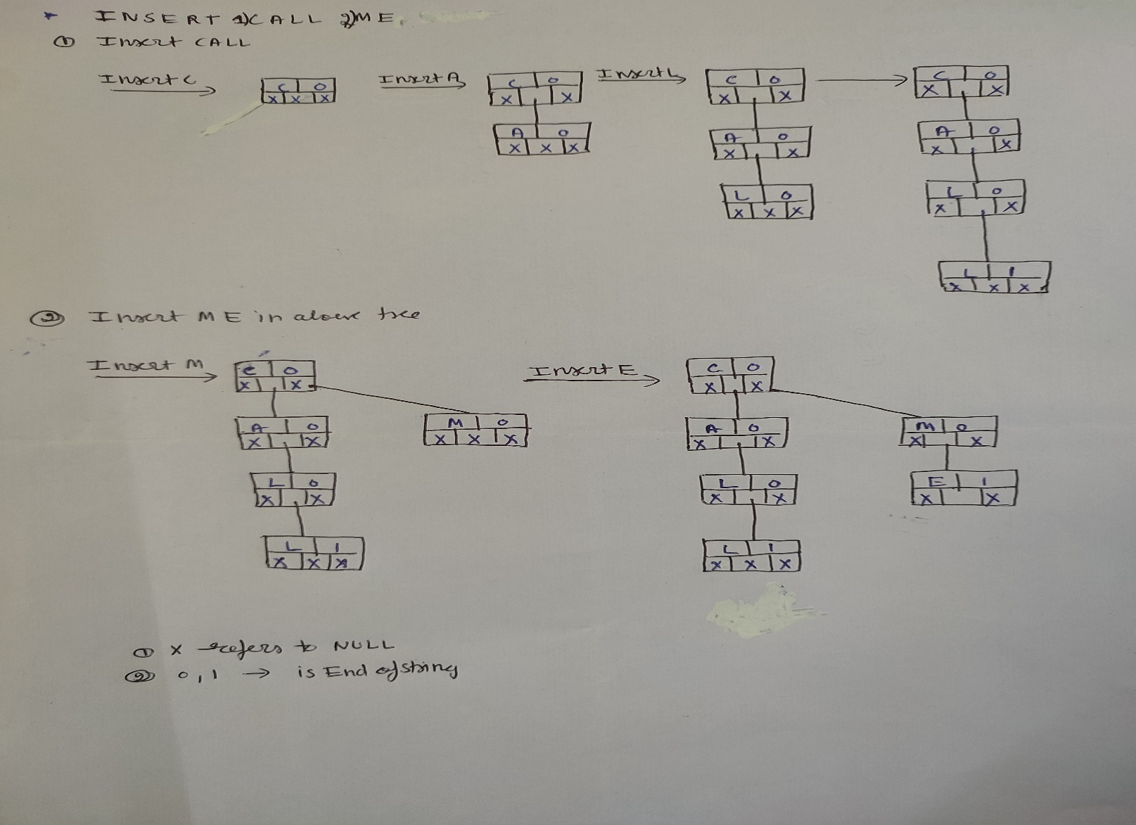
How we performed insertion

Slide 11
Search
To search a node or the data associated with a node a string key is required. firstly we check the first character of the node, if the first character of the string is less than the character in the root node, a recursive lookup can be called on the tree whose root is the left child of the current root. Similarly, if the first character is greater than the current node in the tree, then a recursive call can be made to the tree whose root is the right child of the current node.

Slide 12
As a final case, if the first character of the string is equal to the character of the current node then the function returns the node if all character in key are covered. If there are more characters in the key then the first character of the key must be removed and a recursive call is made given the equal kid node and the modified key.

Slide 13
Autocompletion
Autocomplete is now seen as a popular feature across Search Engine, Integrated Development Environments and Text Editors where various possible word predictions are given for a partially written text. The Autocomplete allows for further efficiency while perform queries and typing and here we will use a Ternary Search Tree to implement this feature.

Slide 14
Ternary Search Tree is regarded as quite efficient compared to the earlier TRIE Data Structure and can perform insertion, deletion and search operation with the same efficiency as a Binary Search Tree. The Space Complexity associated with a Ternary Search Tree is equal to the length of the string that has been stored into it.

Slide 15
Analysis
The run time of the TST depends on the input. The running time of Ternary search trees is best when given several similar strings, especially when those strings share a common prefix. Ternary search trees are effective when storing a large number of relatively short strings such as words in dictionary.
Running times for ternary search trees are similar to binary search trees , typically run in logarithmic time, but can run in linear time in the degenerate case.

Slide 16
Time complexities for ternary search tree operations:
 | AVERAGE CASE | WORST CASE
Insertion | O(log n) | O(n)
Deletion | O(log n) | O(n)
Search | O(log n) | O(n)

Slide 17
Comparisons
As compared to binary search tree each comparison in Ternary search tree is much simpler. Each node requires only a constant amount of storage therefore its most space efficient and that comparison is a constant-time operation Recursion is truly trivial in TST.
Compare this to a binary search tree, where you may have to compare multiple characters at any node, each node must contain an entire string.

Slide 18
It is slower as compare to tries therefore ternary search trees can be better suited for larger data sets due totheir space-efficiency

Slide 19
References
Wally Flint. Plant your data in ternary search tree. pages 1–2, 2001.
Igor Ostrovsky. efficient autocomplete with ternary search tree. page 1.
Lukasz Wrobel. Ternary search tree. page 1, 210.

